Slide 1
ANOMALY DETECTION
Most of the material in this presentation taken from Text Book slides (Tan et. al.)

Slide 2
Anomaly
Outliers
Deviation detection
Exception mining
Read the book “Outliers” by Malcolm Gladwell

Slide 3
Anomaly/Outlier Analysis
What are outliers?
Outlier (noun) : something that is situated away from or classed differently from a main or related body
A statistical observation that is markedly different in value from the others of the sample
The set of objects are considerably dissimilar from the remainder of the data
Example: Sports: Michael Jordon, Sachin Tendulkar, Tiger Woods

Slide 4
Anomaly/Outlier Analysis
Telecom fraud detection
Terrorism Prevention
An error/defect in a 6σ company
(Mumbai’s Dabbawallas)
Fraud
Intrusion
Earthquake or Tsunami
Outbreak of a disease
Rare disease
Exceptionally talented athletes

Slide 5
Anomaly/Outlier Detection
What are anomalies/outliers?
The set of data points that are considerably different than the remainder of the data
Variants of Anomaly/Outlier Detection Problems
Given a database D, find all the data points x ∈ D with anomaly scores greater than some threshold t
Given a database D, find all the data points x ∈ D having the top-n largest anomaly scores f(x)
Given a database D, containing mostly normal (but unlabeled) data points, and a test point x, compute the anomaly score of x with respect to D
Applications:
Credit card fraud detection, telecommunication fraud detection, network intrusion detection, fault detection

Slide 6
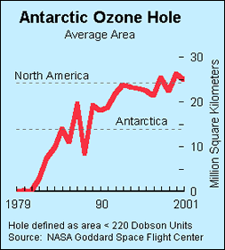
Importance of Anomaly Detection
Ozone Depletion History
In 1985 three researchers (Farman, Gardinar and Shanklin) were puzzled by data gathered by the British Antarctic Survey showing that ozone levels for Antarctica had dropped 10% below normal levels
Why did the Nimbus 7 satellite, which had instruments aboard for recording ozone levels, not record similarly low ozone concentrations?
The ozone concentrations recorded by the satellite were so low they were being treated as outliers by a computer program and discarded!
Sources: http://exploringdata.cqu.edu.au/ozone.html http://www.epa.gov/ozone/science/hole/size.html

Slide 7
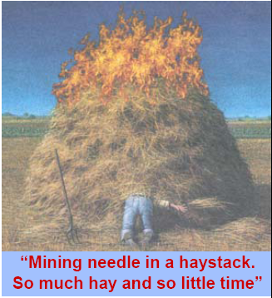
Anomaly Detection
Challenges
How many outliers are there in the data?
Method is unsupervised
Validation can be quite challenging (just like for clustering)
Finding needle in a haystack
Working assumption:
There are considerably more “normal” observations than “abnormal” observations (outliers/anomalies) in the data
Picture Source: Presentation slides of Prof. Jaideep Srivastava

Slide 8
Causes of Anomalies
Data from different classes
Measuring the weights of oranges, but a few grapefruit are mixed in
Natural variation
Unusually tall people
Data errors
200 pound 2 year old

Slide 9
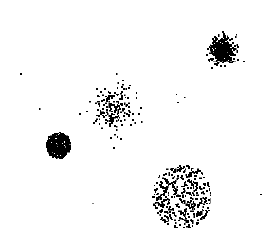
Anomaly Detection Schemes
General Steps
Build a profile of the “normal” behavior
Profile can be patterns or summary statistics for the overall population
Use the “normal” profile to detect anomalies
Anomalies are observations whose characteristics differ significantly from the normal profile
Types of anomaly detection schemes
Graphical & Statistical-based
Distance-based
Model-based

Slide 10
Model‐Based Anomaly Detection
Build a model for the data and see
Unsupervised
Anomalies are those points that don’t fit well
Anomalies are those points that distort the model
Examples:
Statistical distribution
Clusters
Regression
Geometric
Graph
Supervised
Anomalies are regarded as a rare class
Need to have training data

Slide 11
Additional Anomaly Detection Techniques
Proximity‐based
Anomalies are points far away from other points
Can detect this graphically in some cases
Density‐based
Low density points are outliers
Pattern matching
Create profiles or templates of a typical but important events or objects
Algorithms to detect these patterns are usually simple and efficient

Slide 12
Distinction Between Noise and Anomalies
Noise is erroneous, perhaps random, values or contaminating objects
Weight recorded incorrectly
Grapefruit mixed in with the oranges
Noise doesn’t necessarily produce unusual values or objects
Noise is not interesting
Anomalies may be interesting if they are not a result of noise
Noise and anomalies are related but distinct concepts

Slide 13
General Issues: Number of Attributes
Many anomalies are defined in terms of a single attribute
Height
Shape
Color
Can be hard to find an anomaly using all attributes
Noisy or irrelevant attributes
Object is only anomalous with respect to some attributes
However, an object may be anomalous even if none of its attribute values are individually anomalous.

Slide 14
General Issues: Anomaly Scoring
Many anomaly detection techniques provide only a binary categorization
An object is an anomaly or it isn’t
This is especially true of classification‐based approaches
Other approaches assign a score to all points
This score measures the degree to which an object is an anomaly
This allows objects to be ranked
In the end, you often need a binary decision
Should this credit card transaction be flagged?
Still useful to have a score
How many anomalies are there?

Slide 15
Other Issues for Anomaly Detection
Find all anomalies at once or one at a time
Swamping
Masking
Evaluation
How do you measure performance?
Supervised vs. unsupervised situations
Efficiency
Context
Professional basketball team

Slide 16
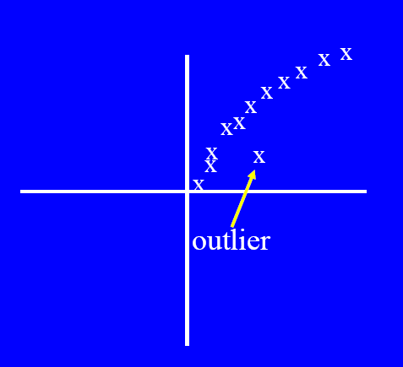
Graphical Approaches
Boxplot (1-D), Scatter plot (2-D), Spin plot (3-D)
Limitations
Time consuming

Slide 17
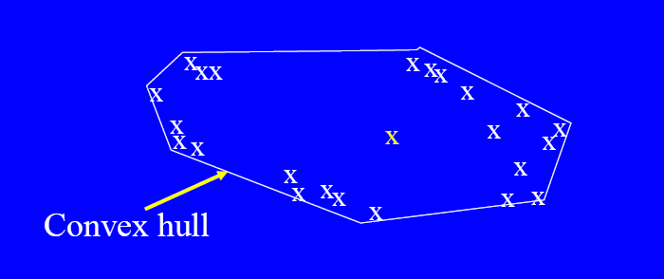
Convex Hull Method
Extreme points are assumed to be outliers
Use convex hull method to detect extreme values
What if the outlier occurs in the middle of the data?

Slide 18
Statistical Approaches
Probabilistic definition of an outlier: An outlier is an object that has a low probability with respect to a probability distribution model of the data.
Usually assume a parametric model describing the distribution of the data (e.g., normal distribution)
Apply a statistical test that depends on
Data distribution
Parameters of distribution (e.g., mean, variance)
Number of expected outliers (confidence limit)
Issues
Identifying the distribution of a data set
Heavy tailed distribution
Number of attributes
Is the data a mixture of distributions?

Slide 19
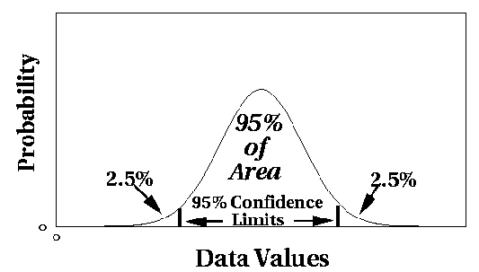
Outlier Discovery: Statistical Approaches
Assume a model underlying distribution that generates data set (e.g. normal distribution)
Use discordancy tests depending on
data distribution
distribution parameter (e.g., mean, variance)
number of expected outliers
Drawbacks
most tests are for single attribute
In many cases, data distribution may not be known

Slide 20
Grubbs’ Test
Detect outliers in univariate data
Assume data comes from normal distribution
Detects one outlier at a time, remove the outlier, and repeat
H₀: There is no outlier in data
H_{A}: There is at least one outlier
Grubbs’ test statistic:
Reject H₀ if:

Slide 21
Statistical-based–Likelihood Approach
Assume the data set D contains samples from a mixture of two probability distributions:
M (majority distribution)
A (anomalous distribution)
General Approach:
Initially, assume all the data points belong to M
Let L_{t}(D) be the log likelihood of D at time t
For each point x_{t} that belongs to M, move it to A
Let L_{t+1} (D) be the new log likelihood.
Compute the difference, Δ = L_{t}(D) – L_{t+1} (D)
If Δ > c (some threshold), then x_{t} is declared as an anomaly and moved permanently from M to A

Slide 22
Statistical‐based – Likelihood Approach

Slide 23
Strengths/Weaknesses of Statistical Approaches
Firm mathematical foundation
Can be very efficient
Good results if distribution is known
In many cases, data distribution may not be known
For high dimensional data, it may be difficult to estimate the true distribution
Anomalies can distort the parameters of the distribution
Most of the tests are for a single attribute

Slide 24
Distance‐Based Approaches
Several different techniques
An object is an outlier if a specified fraction of the objects is more than a specified distance away (Knorr, Ng 1998)
Some statistical definitions are special cases of this
The outlier score of an object is the distance to its kth nearest neighbor

Slide 25
Distance-based Approaches
Data is represented as a vector of features
Three major approaches
Nearest-neighbor based
Density based
Clustering based

Slide 26
Nearest-Neighbor Based Approach
Approach:
Compute the distance between every pair of data points
Outlier score of an object is given by the distance to its k-nearest neighbor
There are various ways to define outliers:
Data points for which there are fewer than p neighboring points within a distance D
The top n data points whose distance to the kth nearest neighbor is greatest
The top n data points whose average distance to the k nearest neighbors is greatest

Slide 27
Nearest-Neighbor Based Approach
K=5

Slide 28
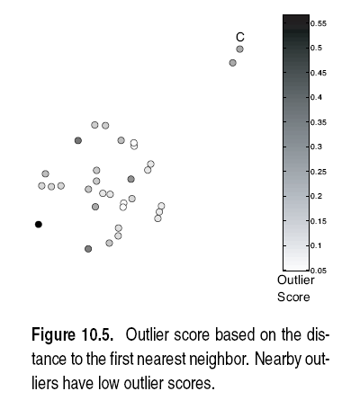
Nearest-Neighbor Based Approach
Approach highly sensitive to choice of K
K=1

Slide 29
Nearest-Neighbor Based Approach
Approach highly sensitive to choice of K
K=5
All points in smaller cluster have high Outlier Score
How to reduce sensitivity on K?
Complexity?

Slide 30
Nearest-Neighbor Based Approach

Slide 31
Nearest-Neighbor Based Approach
Strengths & Weaknesses
+ simple
Complexity O(m²)
Sensitive to choice of parameters
Wide density variations not handles properly (global thresholds are used)
Distance becomes less meaningful in high dimensional space

Slide 32
Density‐Based Approaches
Density‐based Outlier: The outlier score of an object is the inverse of the density around the object.
Can be defined in terms of the k nearest neighbors
One definition: Inverse of distance to kth neighbor
Another definition: Inverse of the average distance to k neighbors
DBSCAN definition
If there are regions of different density, this approach can have problems

Slide 33
Relative Density
Consider the density of a point relative to that of its k nearest neighbors

Slide 35
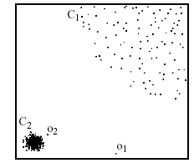
Density-based: LOF approach
For each point, compute the density of its local neighborhood
Compute local outlier factor (LOF) of a sample p as the average of the ratios of the density of sample p and the density of its nearest neighbors
Outliers are points with largest LOF value
In the NN approach, p₂ is not considered as outlier, while LOF approach find both p₁ and p₂ as outliers
p₂
×
p₁
×

Slide 36
Strengths/Weaknesses of Density‐Based Approaches
Simple
Expensive – O(n2)
Sensitive to parameters
Density becomes less meaningful in high dimensional space

Slide 37

Clustering-Based
Basic idea:
Cluster the data into groups of different density
Choose points in small cluster as candidate outliers
Compute the distance between candidate points and non-candidate clusters.
If candidate points are far from all other non-candidate points, they are outliers

Slide 38
Clustering‐Based Approaches
Clustering‐based Outlier: An object is a cluster‐based outlier if it does not strongly belong to any cluster
For prototype‐based clusters, an object is an outlier if it is not close enough to a cluster center
For density‐based clusters, an object is an outlier if its density is too low
For graph‐based clusters, an object is an outlier if it is not well connected
Other issues include the impact of outliers on the clusters and the number of clusters

Slide 41
Strengths/Weaknesses of Cluster‐Based Approaches
Simple
Many clustering techniques can be used
Can be difficult to decide on a clustering technique
Can be difficult to decide on number of clusters
Outliers can distort the clusters

Slide 42
Outliers in Lower Dimensional Projection
In high-dimensional space, data is sparse and notion of proximity becomes meaningless
Every point is an almost equally good outlier from the perspective of proximity-based definitions
Lower-dimensional projection methods
A point is an outlier if in some lower dimensional projection, it is present in a local region of abnormally low density

Slide 43

Outliers in Lower Dimensional Projection
Divide each attribute into φ equal-depth intervals
Each interval contains a fraction f = 1/φ of the records
Consider a k-dimensional cube created by picking grid ranges from k different dimensions
If attributes are independent, we expect region to contain a fraction f^{k} of the records
If there are N points, we can measure sparsity of a cube D as:
Negative sparsity indicates cube contains smaller number of points than expected

Slide 44
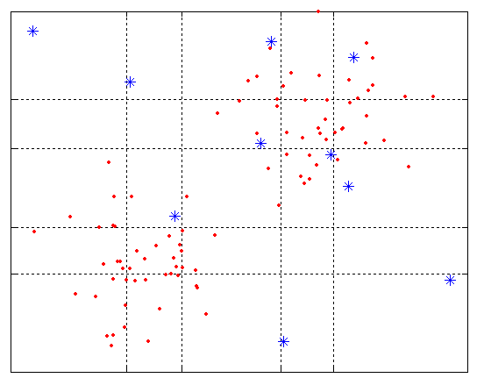
Example
N=100, φ = 5, f = 1/5 = 0.2, N × f² = 4

Slide 45


Base Rate Fallacy
Bayes theorem:
More generally:

Slide 46
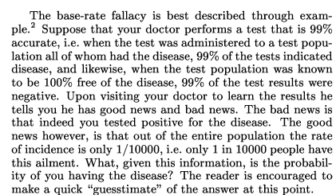
Base Rate Fallacy (Axelsson, 1999)

Slide 47


Base Rate Fallacy
Even though the test is 99% certain, your chance of having the disease is 1/100, because the population of healthy people is much larger than sick people

Slide 48
Base Rate Fallacy in Intrusion Detection
I: intrusive behavior, ¬I: non-intrusive behavior A: alarm ¬A: no alarm
Detection rate (true positive rate): P(A|I)
False alarm rate: P(A|¬I)
Goal is to maximize both
Bayesian detection rate, P(I|A)
P(¬I|¬A)

Slide 49



Detection Rate vs False Alarm Rate
Suppose:
Then:
False alarm rate becomes more dominant if P(I) is very low

